Slide 1
Syllabus
UNIT-I:
Object-oriented thinking
A way of viewing world – Agents and Communities, messages and methods, Responsibilities, Classes and Instances, Class Hierarchies-, Summary of Object-Oriented concepts. History of object-oriented programming, overview of java, Object oriented design, Structure of java program, Java buzzwords, Data types, Variables and Arrays, operators, expressions, control statements, Introducing classes, Methods and Classes, String handling.

Slide 2
Inheritance
Inheritance concept, Inheritance basics, Inheritance, Method binding, Overriding and Exceptions Member access, Constructors, Creating Multilevel hierarchy, super uses, using final with inheritance, Polymorphism-ad hoc polymorphism, pure polymorphism, method overriding, abstract classes, Object class, forms of inheritance- specialization, specification, construction, extension, limitation, combination, benefits of inheritance, costs of inheritance.

Slide 3
Object Oriented Programming
OOP is an approach to program organization and development, which attempts to eliminate some of the drawbacks of conventional programming methods by incorporating the best of structured programming features with several new concepts.

Slide 4
Object Oriented Programming
OOP allows us to decompose a problem into number of entities called objects and then build data and methods (functions) around these entities.

Slide 5
A way of viewing world – Agents & communities
OOP uses an approach of treating a real world agent as an object.
Object-oriented programming organizes a program around its data (that is, objects) and a set of well-defined interfaces to that data.
Ex: booking a cab

Slide 6
A way of viewing world – Agents & communities
Cab booking
Source, destination
Type: micro, mini, max
Applies some method
Fare ( busy hours, normal, office hrs
Cancel trip( delay)
Pick up, dropping
Payment method(cash, paytm, g pay etc)

Slide 7
A way of viewing world – Agents & communities
Agent : ola (uber, orange cabs)
Message: request
Responsibility : to process the request
Agent uses some method to perform or process the request. The method that the agent uses is hidden from the customer.
So, in object-oriented programming, problem-solving is the solution to our problem which requires the help of many individuals in the community.

Slide 8
A way of viewing world – Agents & communities
An object-oriented program is structured as a community of interacting agents, called objects. Where each object provides a service (data and methods) that is used by other members of the community.
Example: Online car booking system is a community in which the agents are ola and set of cars.
Each agent provides a variety of services that can be used by other members like me, you in the community.

Slide 9
Messages and methods
In this scenario, first a request is sent to the agent ola, which led to still more requests among the members of the community until our request has done or processed. Here, the members of a community interact with one another by making requests until the problem has satisfied.

Slide 10
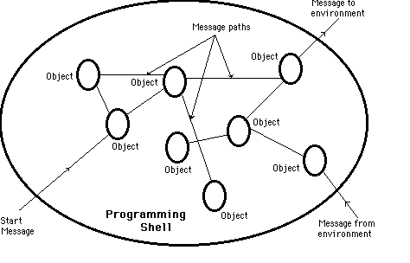
messages and methods

Slide 11
messages and methods
In object-oriented programming, every action is initiated by passing a message to an agent (object), which is responsible for the action. The receiver is the object to whom the message was sent. In response to the message, the receiver performs some method to carry out the request. Every message may include any additional information as arguments.
In our example, we send a request to ola with a message that contains destination information, type of car. The receiver uses a method to send cab to our home.

Slide 12
Responsibilities
In object-oriented programming, behavior of an object is described in terms of responsibilities.
In our example, my request for action indicates only the desired outcome (cab pick up dropping). The agent (ola) is free to use any technique that solves this problem.

Slide 13
Classes and Instances
In object-oriented programming, all objects are instances of a class.
Object is a Physical entity
Objects have two characteristics: states and behaviors.
States represents data and behavior represents functionality
Example: Apple, orange, mango are the objects of class fruit.
Parrot, crow, pigeon are the objects of the class Bird
Each object is identified by a unique name.

Slide 14
Classes and Instances
Class is a collection of objects that have identical properties, common behavior and shared relationship
Class is a Blueprint
Class is a logical entity.
Once a class is defined, any number of objects of that class can be created
Classes are user defined data types.
A class can hold both data and functions.
Example: Fruit, Bird

Slide 15
Classes and Instances
Example :
Class: Bird
Object : crow
States: no of wings, color
Behavior: fly,eat
Class : Fruit
Object: apple, mango, grape, banana, pears, orange
States: color, taste, seeds, season
Behavior: growup, usage

Slide 16
class
FIGURE
Ob1
Ob3
Hexagon
Ob2
SQUARE
RECTANGLE

Slide 17
Class Hierarchies-Inheritance
A graphical representation is often used to illustrate the relationships among the classes (objects) of a community. This graphical representation shows classes listed in a hierarchical tree-like structure.
In object-oriented programming, classes can be organized into a hierarchical inheritance structure. A child class inherits properties from the parent class that higher in the tree.
Inheritance allows to reuse classes by deriving a new class from an existing one
The existing class is called the parent class, or superclass, or base class
The derived class is called the child class or subclass.
The child class inherits characteristics of the parent class(i.e the child class inherits the methods and data defined for the parent class
In this more abstract class listed near the top of the tree, and more specific classes in the middle of the tree, and the individuals listed near the bottom.

Slide 18
Method binding, Overriding and Exceptions
In the class hierarchy, both parent and child classes may have the same method which implemented individually. Here, the implementation of the parent is overridden by the child. Or a class may provide multiple definitions to a single method to work with different arguments (overloading).
The search for the method to invoke in response to a request (message) begins with the class of this receiver. If no suitable method is found, the search is performed in the parent class of it. The search continues up the parent class chain until either a suitable method is found or the parent class chain is exhausted. If a suitable method is found, the method is executed. Otherwise, an error message is issued.

Slide 19
Summary of Object-Oriented concepts.
The following are the basic oops concepts.
They are as follows:
Objects.
Classes.
Data Encapsulation.
Inheritance.
Polymorphism.
Data Abstraction.

Slide 20
Objects and classes
all objects are instances of a class.
Class is a collection of objects that have identical properties, common behavior and shared relationship

Slide 21
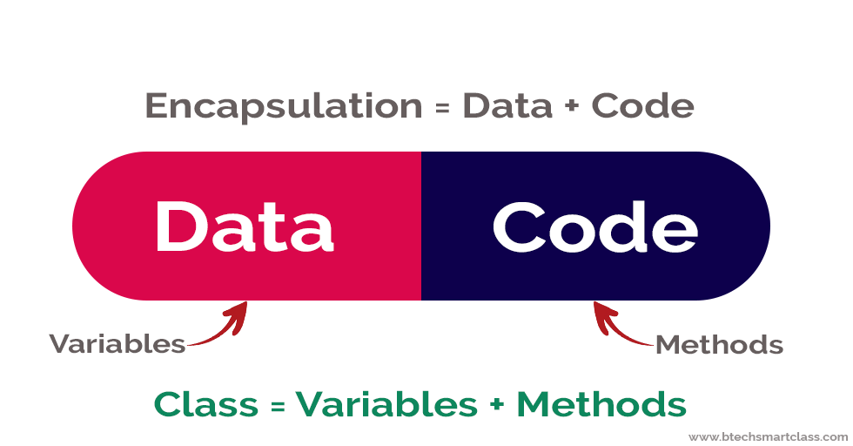
Encapsulation
Encapsulation is the process of combining data and code into a single unit (object / class).
In OOP, every object is associated with its data and code.
In programming, data is defined as variables and code is defined as methods.
The java programming language uses the class concept to implement encapsulation.

Slide 22
Inheritance
Inheritance is the process of acquiring properties and behaviors from one object to another object or one class to another class.
In inheritance, we derive a new class from the existing class.
Here, the new class acquires the properties and behaviors from the existing class.
In the inheritance concept, the class which provides properties is called as parent class
and the class which receives the properties is called as child class.
The parent class is also known as base class or super class. The child class is also known as derived class or sub class.
In the inheritance, the properties and behaviors of base class extended to its derived class, but the base class never receive properties or behaviors from its derived class.

Slide 23
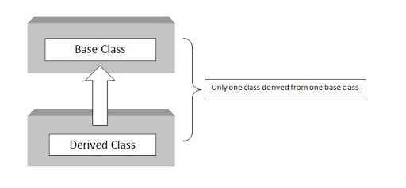
Inheritance

Slide 24
Polymorphism.
Polymorphism is the process of defining same method with different implementations.
Polymorphism means creating multiple methods with different behaviors.
The java uses method overloading and method overriding to implement polymorphism.
Method overloading - multiple methods with same name but different parameters.
Method overriding - multiple methods with same name and same parameters.

Slide 25
Abstraction
Abstraction means hiding internal details and showing only functionality.
In the abstraction concept, we do not show the actual implementation to the end user, instead we provide only essential things.
In Java, we use abstract class and interface to achieve abstraction.

Slide 26
History of object-oriented programming & java
Computer language innovation and development occurs for two fundamental reasons:
1) to adapt to changing environments and uses
2) to implement improvements in the art of programming
The development of Java was driven by both in equal measures.

Slide 27
History of object-oriented programming & java
Many Java features are inherited from the earlier languages:
B 🡪 C 🡪 C++ 🡪 Java
C is structured, efficient, high-level language that could replace assembly code when creating systems programs.
C++ extends C by adding object-oriented features.

Slide 28
History of object-oriented programming & java
In 1990, Sun Microsystems started a project called Green to develop software for consumer electronics.
James Gosling, Mike Sheridan, and Patrick Naughton are formed together called Green Team and initiated the project.
Firstly, it was called "Greentalk" by James Gosling, and the file extension was .gt.
After that, it was called Oak and was developed as a part of the Green project.

Slide 29
History of object-oriented programming & java
Oak is a symbol of strength and chosen as a national tree of many countries like the U.S.A., France, Germany, Romania, etc.
In 1995, Oak was renamed as "Java" because it was already a trademark by Oak Technologies.
The team gathered to choose a new name. The suggested words were "dynamic", "revolutionary", "Silk", "jolt", "DNA", etc. They wanted something that reflected the essence of the technology: revolutionary, dynamic, lively, cool, unique, and easy to spell and fun to say.

Slide 30
History of object-oriented programming & java
According to James Gosling, "Java was one of the top choices along with Silk". Since Java was so unique, most of the team members preferred Java than other names.
Java is an island of Indonesia where the first coffee was produced (called java coffee). It is a kind of espresso bean. Java name was chosen by James Gosling while having coffee near his office.
Java is just a name, not an acronym.

Slide 31
History of object-oriented programming & java
There are many java versions that has been released. JDK Alpha and Beta (1995)
JDK 1.0 (23rd Jan, 1996)
JDK 1.1 (19th Feb, 1997)
J2SE 1.2 (8th Dec, 1998)
J2SE 1.3 (8th May, 2000)
J2SE 1.4 (6th Feb, 2002)
J2SE 5.0 (30th Sep, 2004)
Java SE 6 (11th Dec, 2006)
Java SE 7 (28th July, 2011)
Java SE 8 (18th March, 2014)

Slide 32
History of object-oriented programming & java
Java SE 9(September 2017)
Java SE 10(March 2018)
Java SE 11 (September 2018)
Java SE 12(March 2019)
Java SE 13(September 2019)
Java SE 14(March 2020)
Java SE 15(September 2020)
Java SE 16(March 2021)
Java SE 17 (LTS)September 2021

Slide 33
Java Buzzwords(Features)
Features of java:
Simple
Object-oriented
Platform Independent
Robust
Architectural Neutral
6. Multithreaded
7. Interpreted and high-performance
8. Distributed
9. Dynamic
10. Secure
11. portable

Slide 34
1. Simple
User Friendly Syntax
Free From Pointer
Rich Set Of API
Garbage Collector
No Operator Overloading

Slide 35
2. Object-oriented
Object-oriented means we organize our software as a combination of different types of objects that incorporates both data and behaviour.
Object-oriented programming aim is to implement real-world entities like inheritance, hiding, polymorphism, etc in programming.
Java supports all these features and In Java everything is an object

Slide 36
3.Platform Independent
Java code can be run on multiple platforms, for example, Windows, Linux, Sun Solaris, Mac/OS, etc. Java code is compiled by the compiler and converted into bytecode. This bytecode is a platform-independent code because it can be run on multiple platforms, i.e., Write Once and Run Anywhere(WORA).

Slide 37
4. Robust
Means Strong
restricts the programmer to find the mistakes early
performs compile-time (strong typing)
and run-time (exception-handling) checks,
manages memory automatically (automatic garbage collection)
lack of pointer concept
Exception Handling.

Slide 38
5. Architectural Neutral
Run on any available processors in the real world without considering their development and compilation.
Java Virtual Machine provides a platform independent environment for the execution of Java byte code
Java is architecture neutral because there are no implementation dependent features, for example, the size of primitive types is fixed.
In C programming, int data type occupies 2 bytes of memory for 32-bit architecture and 4 bytes of memory for 64-bit architecture. However, it occupies 4 bytes of memory for both 32 and 64-bit architectures in Java.

Slide 39
6. Multithreaded
A thread is like a separate program, executing concurrently.
We can write Java programs that deal with many tasks at once by defining multiple threads.
Threads are important for multi-media, Web applications, etc.

Slide 40
7. Interpreted and high-performance
Java programs are compiled into an intermediate representation – byte code:
a) can be later interpreted by any JVM
b) can be also translated into the native machine code for efficiency.

Slide 41
8. Distributed
Java is distributed because it facilitates users to create distributed applications in Java. RMI and EJB are used for creating distributed applications. This feature of Java makes us able to access files by calling the methods from any machine on the internet.

Slide 42
9.Dynamic
Supports Dynamic memory allocation
It supports dynamic loading of classes. It means classes are loaded on demand. It also supports functions from its native languages, i.e., C and C++.
Java supports dynamic compilation and automatic memory management (garbage collection).

Slide 43
10.Secured
Java is secured because any explicit pointers are not used and Java Programs run inside a virtual machine sandbox.
Class loader (part of JRE) adds security by separating the package for the classes of the local file system from those that are imported from network sources.
Bytecode Verifier: It checks the code fragments for illegal code that can violate access right to objects.

Slide 44
11. Portable
Java is portable because it facilitates you to carry the Java bytecode to any platform. It doesn't require any implementation.

Slide 45
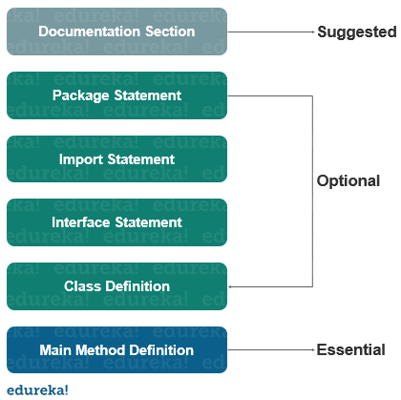
Structure of Java Program
Comments
Package statement
Import statement
Interface statement
Class defination
Main method class

Slide 46
Documentation section
a comment describes or explains the operation of the program to anyone who is reading its source code.
The contents of a comment are ignored by the compiler.
A single-line comment : begins with a //
Multiline comment: This type of comment must begin with /* and end with */
documentation comment: /** documentation */
The JDK javadoc tool uses doc comments when preparing automatically generated documentation.

Slide 47
Package Statement
Java allows to declare classes in a collection called package.
There can be only one package statement in a Java program and it has to be at the beginning of the code before any class or interface declaration.
This statement is optional.
Ex: package tkrcse;
This statement declares that all the classes and interfaces defined in this source file are a part of the tkrcse package.
Only one package can be declared in the source file.

Slide 48
Import Statement
The predefined classes are stored in packages in Java.
An import statement is used to refer to the classes stored in other packages.
An import statement is always written after the package statement but it has to be before any class declaration.
We can import a specific class or classes in an import statement.
Ex: import java.util.Date; //imports the date class
import java.applet.*; //imports all the classes from the java applet package
Every program in java, by default imports java.lang.* package

Slide 49
Interface statement
An interface is a lot similar to a class in Java but it contains only constants and method declarations.
Used to specify an interface in Java.
It is an optional section which is mainly used to implement multiple inheritance in Java.
An interface cannot be instantiated but it can be implemented by classes or extended by other interfaces.

Slide 50
Class Definition
A Java program may contain several class definitions, classes are an essential part of any java program.
It defines the information about the user-defined classes in a program.
A class is a collection of variable and methods that operate on the fields.
Every program in Java will have at least one class with the main method.
Main Method Class
The main method is from where the execution actually starts and follows the order specified for the following statements

Slide 51
Example
class Ex1{
//main method declaration
public static void main(String args[])
{
System.out.println("hello world");
}
}

Slide 52
Example
Save the file as Ex1.java
Compile the file by giving the command javac Ex1.java
execute: java Ex1

Slide 53
Data types
Data types specify the different sizes and values that can be stored in the variable.
Primitive: The primitive data types are built-in data types and they specify the type of value stored in a variable and the memory size
Non-primitive: Non-primitive data types are the reference data types or user-created data types. All non-primitive data types are implemented using object concepts. Every variable of the non-primitive data type is an object.

Slide 54
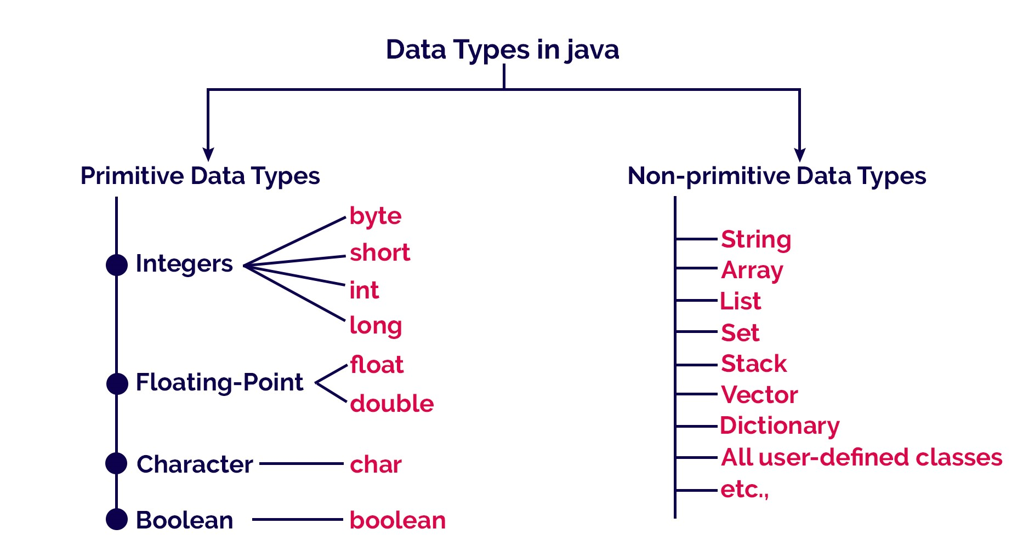

Slide 55
VARIABLE
Name of the memory location used to store data
Variable is an identifier which can be used to identify input data in a program.
Syntax:Variable_name = value;

Slide 56
Rules to declare a Variable
Allowed characters for identifiers are [A-Z],[a-z],[0-9], ‘$‘(dollar sign) and ‘_‘ (underscore).
should not start with digits([0-9])
case-sensitive
No space are allowed .
Reserved Words can’t be used as an identifier.
Maximum length of variable is 64 characters

Slide 57
Variable declarations
Syntax: Datatype variable_name;
Ex: int b1;
Variable initialization
Syntax: Datatype variable_name= value;
Ex: int b=100;
Variable assignment
Syntax: Datatype Variable_Name = value;
Ex:int b= 100;
int a=b;

Slide 58
Types of variables
Local variables
Instance variables or Member variables or Global variables
Static variables or Class variables
Final variables

Slide 59
Example
class ABC
{ int data=50;//instance variable
static int m=100;//static variable
final static int x=28: // final variable
void method()
{
int n=90;//local variable
}
}//end of class

Slide 60
Identifier
Any Name used to identify a particular element in a program
must have a unique name.
Identifiers are the names of variables, methods, classes, packages and interfaces.
Example : In our Ex1 program, the identifiers are : Ex1, main, args, println.
Rules:
Allowed characters for identifiers are [A-Z],[a-z],[0-9], ‘$‘(dollar sign) and ‘_‘ (underscore).
should not start with digits([0-9])
case-sensitive
No space are allowed
There is no limit
Reserved Words can’t be used as an identifier

Slide 61
Arrays
Java provides a data structure, the array, which stores a fixed-size sequential collection of elements of the same type. An array is used to store a collection of data, but it is often more useful to think of an array as a collection of variables of the same type.
Need of array: Find out average of pass mark in a subject

Slide 62
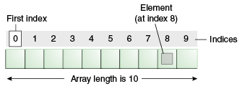
Array
Is a data structure where we store similar elements.
We can store only a fixed set of elements in a Java array.
Array in Java is index-based, the first element of the array is stored at the 0th index, 2nd element is stored on 1st index and so on.

Slide 63
Advantages and Disadvantages
Advantages
Code Optimization: It makes the code optimized; we can retrieve or sort the data efficiently.
Random access: We can get any data located at an index position.
Disadvantages
Size Limit: We can store only the fixed size of elements in the array. It doesn't grow its size at runtime. To solve this problem, collection framework is used in Java which grows automatically.

Slide 64
Types of arrays
Single Dimensional Array: it stores single row of data
Multidimensional Array: it stores the data in the form of rows and columns (matrix form)

Slide 65
Single Dimensional Array
Syntax to Declare an Array
dataType[] arr; (or)
dataType []arr; (or)
dataType arr[];
Instantiation of an Array
Data_type arrayRefVar=new datatype[size]
example: int a[]=new int[5]
Note: Storage for the array itself is not allocated until you use “new”.
For initializing method the “new” command is not needed.
int[] a={5,3,7,89,2};

Slide 66
Initialization is loading the array with the values.
int[] h=new int[5]
h[0]=32;
h[1]=12;
h[2]=66;
h[3]=54;
h[4]=43;

Slide 67
Multidimensional Array
Syntax to Declare Multidimensional Array
dataType[][] arrayRefVar; (or)
dataType [][]arrayRefVar; (or)
dataType arrayRefVar[][]; (or)
dataType []arrayRefVar[];
Example:
int[][] a=new int[3][3]; //3 row and 3 column

Slide 68
Operators

Slide 69
Operators
Operator is a special symbol that tells the compiler to perform specific mathematical or logical Operation. Java supports following lists of operators.
Arithmetic Operators
Unary operators
Relational Operators
Logical Operators
Bitwise Operators
Assignment Operators
Ternary or Conditional Operators

Slide 71
Arithmetic Operators
Java arithmetic operator takes numerical values as operands, operates on them, and returns a single numerical value. Java Arithmetic operators are used for simple mathematic operations, they are
Addition (+)
Substruction (-)
Multiplication (*)
Division (/)
Modulos (%)

Slide 72
Arithmetic Operators
Operator | Example (int A=8, B=3) | Result
+ | A+B | 11
- | A-B | 5
* | A*B | 24
/ | A/B | 2
% | A%4 | 0

Slide 73
Unary operators
Unary operators require only one operand.
Unary operators are used to perform various operations i.e.: incrementing/decrementing a value by one, negating an expression, inverting the value of a Boolean

Slide 74
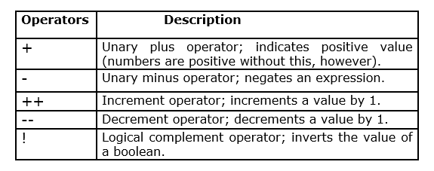
Unary operators

Slide 75
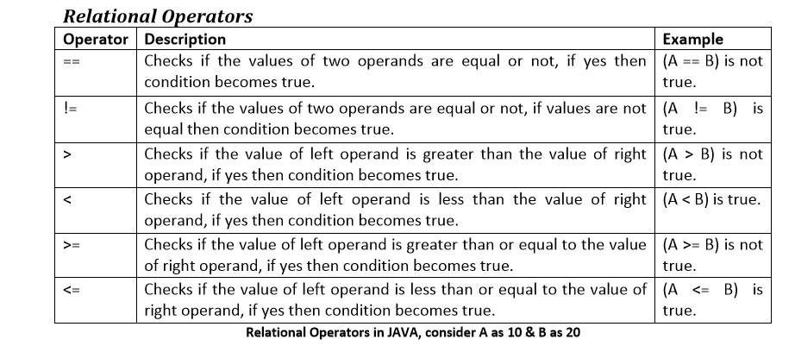
Relational Operators
Which can be used to check the Condition, it always return true or false

Slide 76
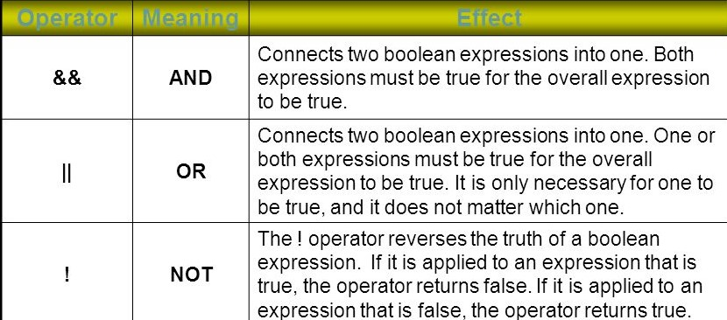
Logical Operators
Which can be used to combine more than one Condition. Suppose you want to combined two conditions A<B and B>C, then you need to use Logical Operator like (A<B) && (B>C). Here && is Logical Operator.

Slide 77
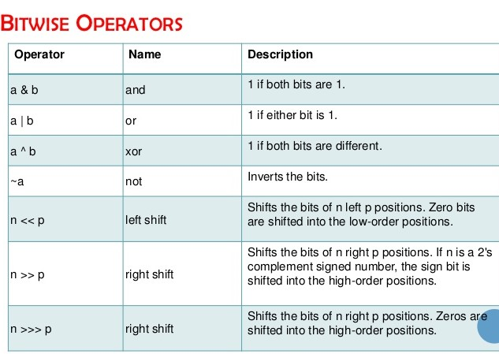
Bitwise Operators
Java's bitwise operators operate on individual bits of integer (int and long) values

Slide 78
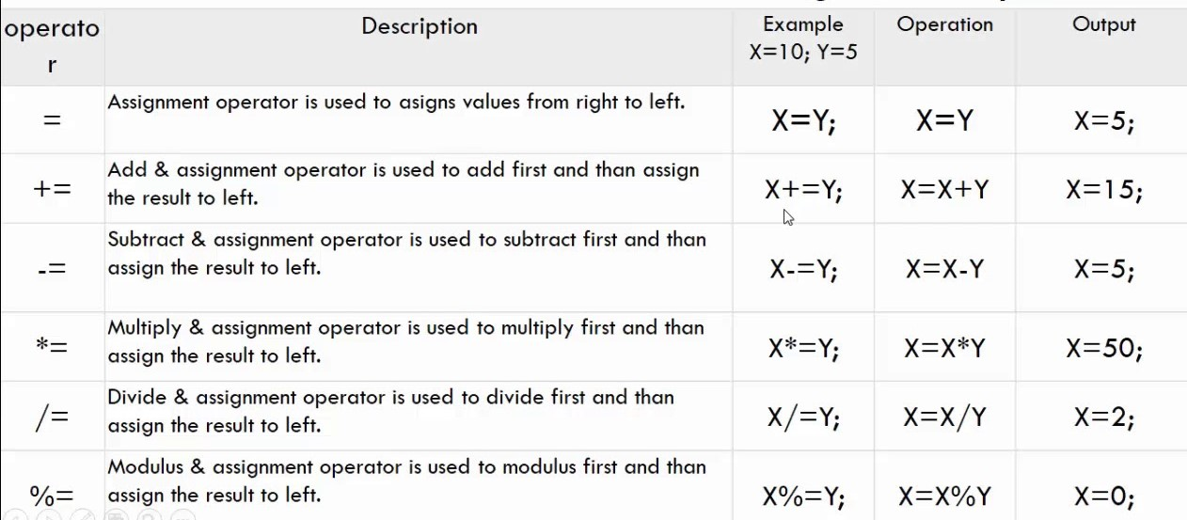
Assignment Operators
used to assign a value to a variable

Slide 79
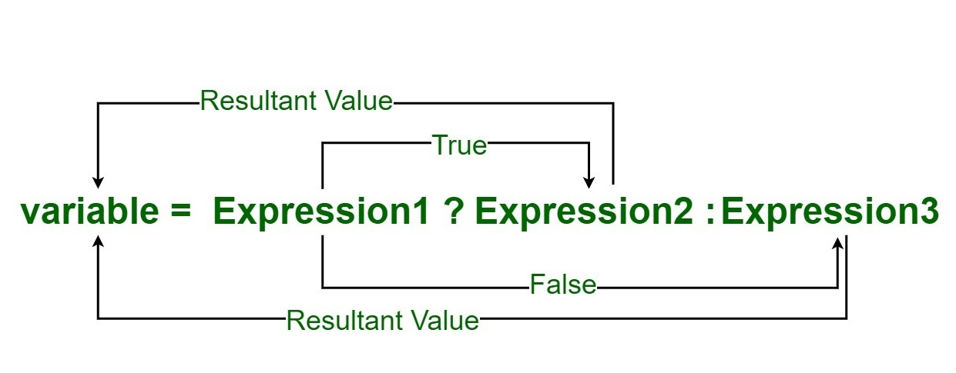
Ternary or Conditional Operators
is used as one liner replacement for if-then-else statement and used a lot in Java programming. it is the only conditional operator which takes three operands
Ex: (a<b)?a:b;
In above example if a is less than the b returns “a” other wise returns “b”

Slide 80
Expressions
Expressions consist of variables, operators, literals and method calls that evaluates to a single value.
Ex:Double a = 2.2, b = 3.4, result;
result = a + b - 3.4;
Here, a + b - 3.4 is an expression.

Slide 81
Operator precedence
Operator precedence determines the grouping of terms in an expression and decides how an expression is evaluated.
Operators with the highest precedence appear at the top of the table, those with the lowest appear at the bottom.
Within an expression, higher precedence operators will be evaluated first.

Slide 82
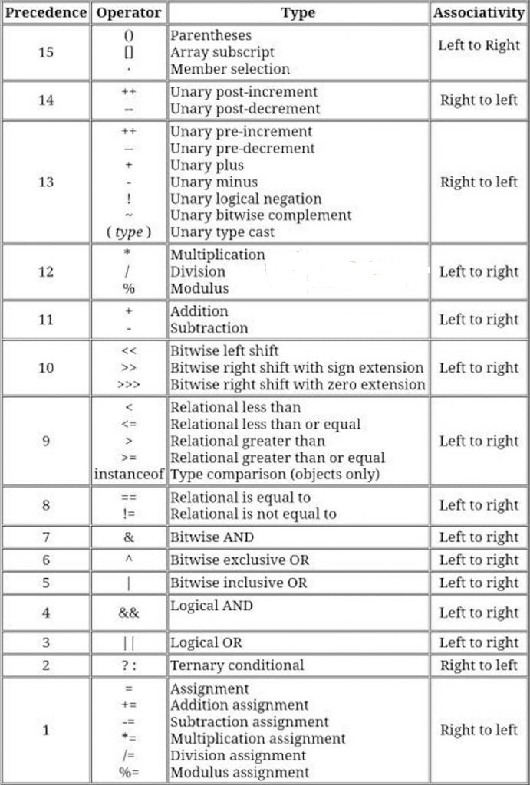

Slide 83
12%6=0
6%12=6
15%7=??
7%15=??
234%4=??
14%26=??
25%5=??

Slide 84
no1% no2=??
no1 - (no2 * int(no1/no2))
6%12= 6- (12*int(6/12)

Slide 85
Control Statements
The statements that control the execution flow of the program are known as control statements.
Specify the order of execution of the statements of a program
They make it possible to make decisions, to perform tasks repeatedly or to jump from one section of code to another.

Slide 86
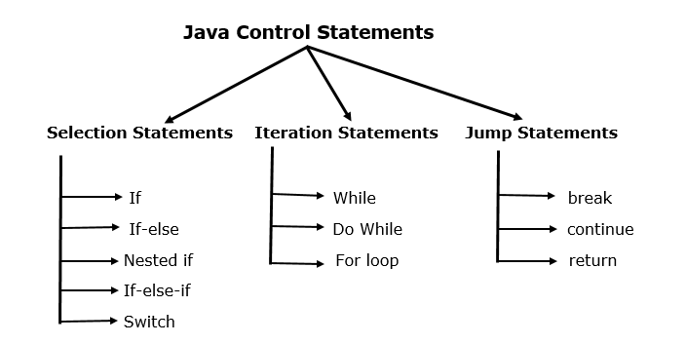

Slide 87
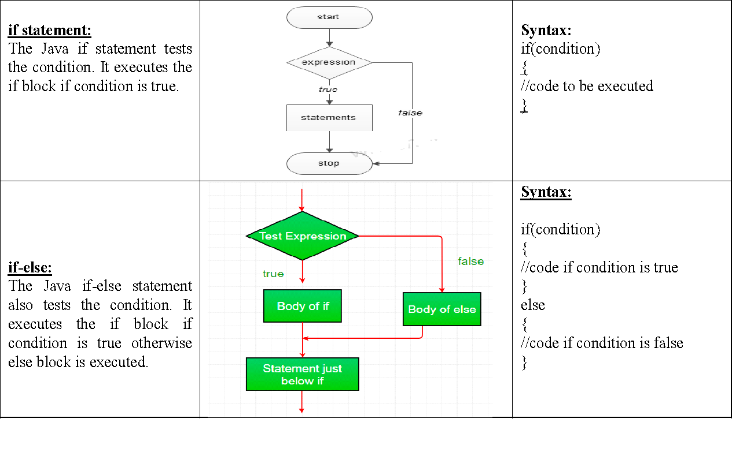
Selection statements

Slide 88
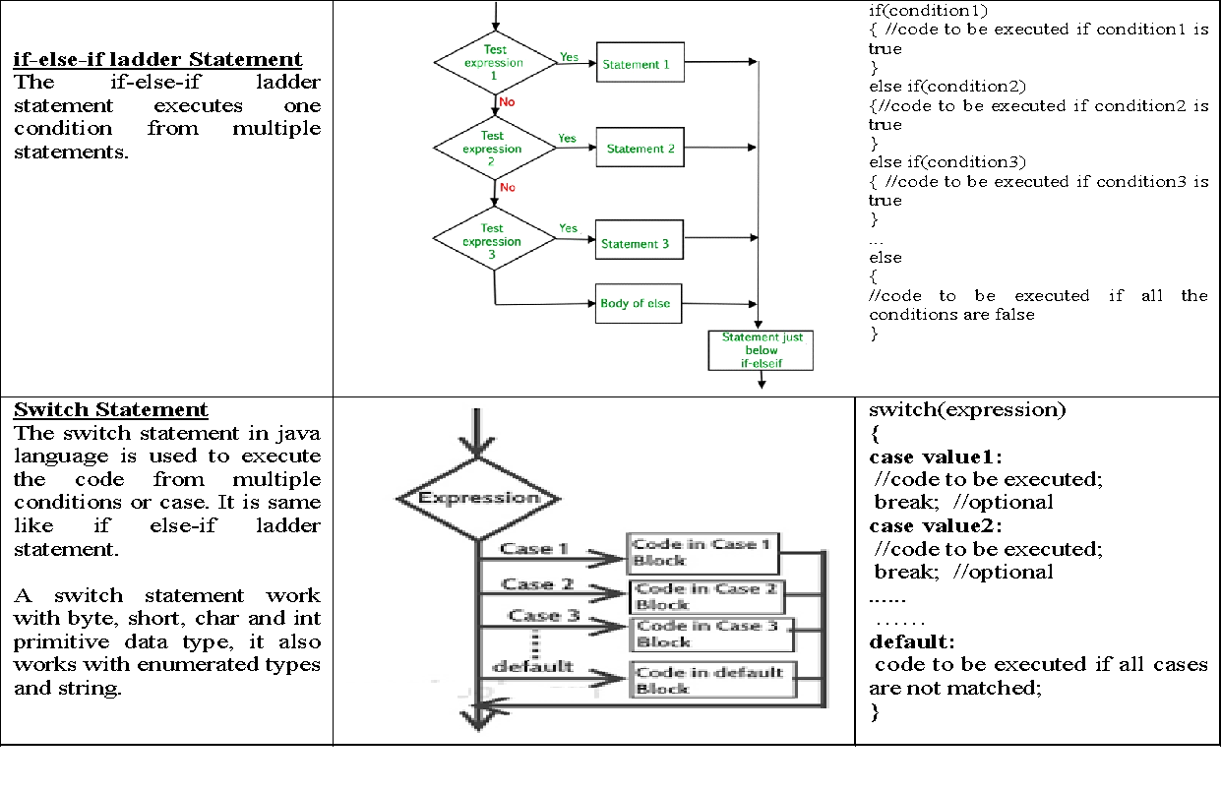
Selection statements

Slide 89
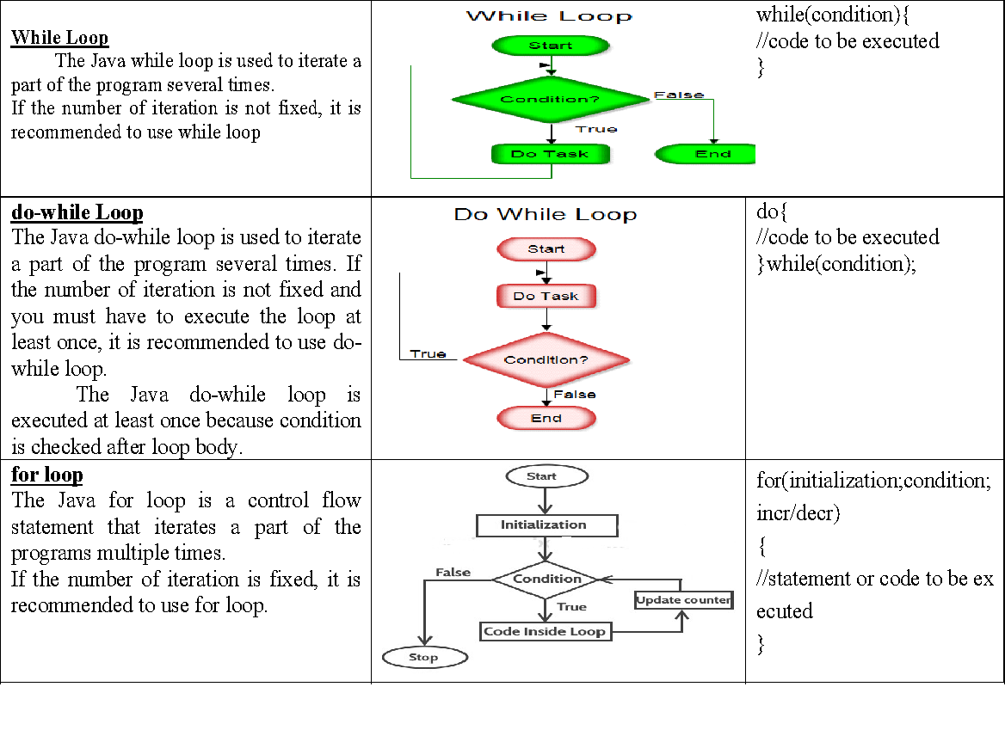
Iteration/looping statements

Slide 90
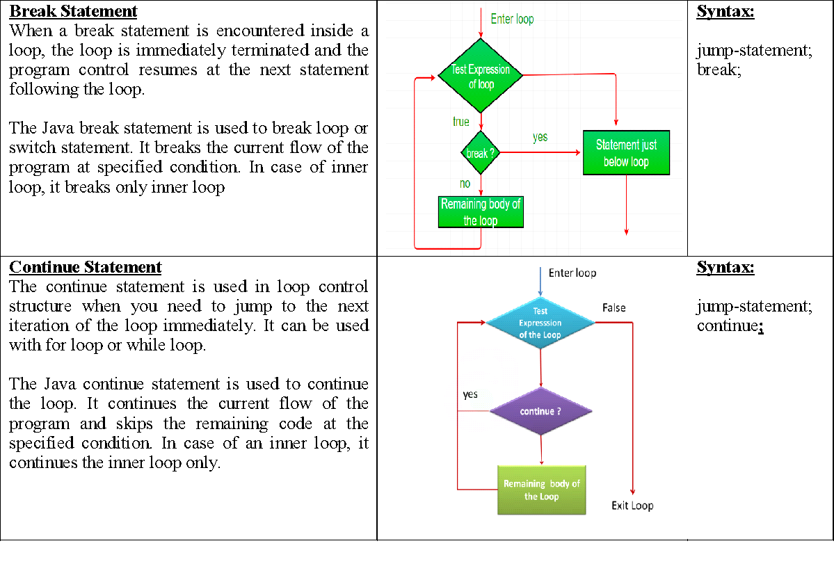
Jump or Transfer statements

Slide 91
First program
/*
This is a simple Java program.
Call this file "Example.java".
*/
class Example
{
public static void main(String args[]) {
System.out.println("This is a simple Java program.");
}
}

Slide 92
The public keyword is an access modifier, which allows the programmer to control the visibility of class members.
When a class member is preceded by public, then that member may be accessed by code outside the class in which it is declared.
In this case, main( ) must be declared as public, since it must be called by code outside of its class when the program is started.
The keyword static allows main( ) to be called without having to instantiate a particular instance of the class. This is necessary since main( ) is called by the Java Virtual Machine before any objects are made.
The keyword void simply tells the compiler that main( ) does not return a value.

Slide 93
Java is case-sensitive
All statements in Java end with a semicolon.
Any information that you need to pass to a method is received by variables specified within the set of parentheses that follow the name of the method. These variables are called parameters.
String args[ ] declares a parameter named args, which is an array of instances of the class String. (Arrays are collections of similar objects.)
Output is actually accomplished by the built-in println( ) method. In this case, println( ) displays the string which is passed to it.
The line begins with System.out.
System is a predefined class that provides access to the system, and out is the output stream that is connected to the console.

Slide 94
Second program
/*
Here is another short example.
Call this file "Example2.java".
*/
class Example2 {
public static void main(String args [])
{
int num; // this declares a variable called num
num = 100; // this assigns num the value 100
System.out.println("This is num: " + num);
num = num * 2;
System.out.print("The value of num * 2 is ");
System.out.println(num);
}
}
When you run this program, you will see the following output:
This is num: 100
The value of num * 2 is 200

Slide 95
+ operator in println is used to join together as many items as required within a single println( ) statement.
The plus sign causes the value of num to be appended to the string that precedes it, and then the resulting string is output.
Actually, num is first converted from an integer into its string equivalent and then concatenated with the string that precedes it.
The print( ) method is just like println( ), except that it does not output a newline character after each call.

Slide 96
If Statement
//Call this file "IfSample.java".
class IfSample
{
public static void main(String args[]) {
int x, y;
x = 10;
y = 20;
if(x < y) System.out.println("x is less than y");
x = x * 2;
if(x == y) System.out.println("x now equal to y");
x = x * 3;
if(x > y) System.out.println("x now greater than y");
// this won't display anything
if(x == y) System.out.println("you won't see this");
}
}
The output generated by this program is shown here:
x is less than y
x now equal to y
x now greater than y

Slide 97
For loop
/*
Demonstrate the for loop.
Call this file "ForTest.java".
*/
class ForTest
{
public static void main(String args[])
{
int x;
for(x = 0; x<10; x = x+1)
System.out.println("This is x: ”+ x);
}
}

Slide 98
This is x: 0
This is x: 1
This is x: 2
This is x: 3
This is x: 4
This is x: 5
This is x: 6
This is x: 7
This is x: 8
This is x: 9
Int a,b; if (a<b) System.out.println(“a is “+a); for(a=0fjfjsjfllkf)

Slide 99
Code blocks
Java allows two or more statements to be grouped into blocks of code, called as code blocks.
This is done by enclosing the statements between opening and closing curly braces.
if(x < y)
{ // begin a block
x = y;
y = 0;
}
// end of block

Slide 100
Lexical Issues
Java programs are a collection of whitespace, identifiers, literals, comments, operators, separators, and keywords. These atomic elements of Java are called as lexical issues.
In Java, whitespace is a space, tab, or newline.
Identifiers are used to name things, such as classes, variables, and methods.
A constant value in Java is created by using a literal representation of it. Ex: 100,23.5, ‘X’ ‘, “This is a test”

Slide 101
Seperators are used to terminate statements. The following are the seperators
( ) ,
{ },
[],
;
.
,
::

Slide 102
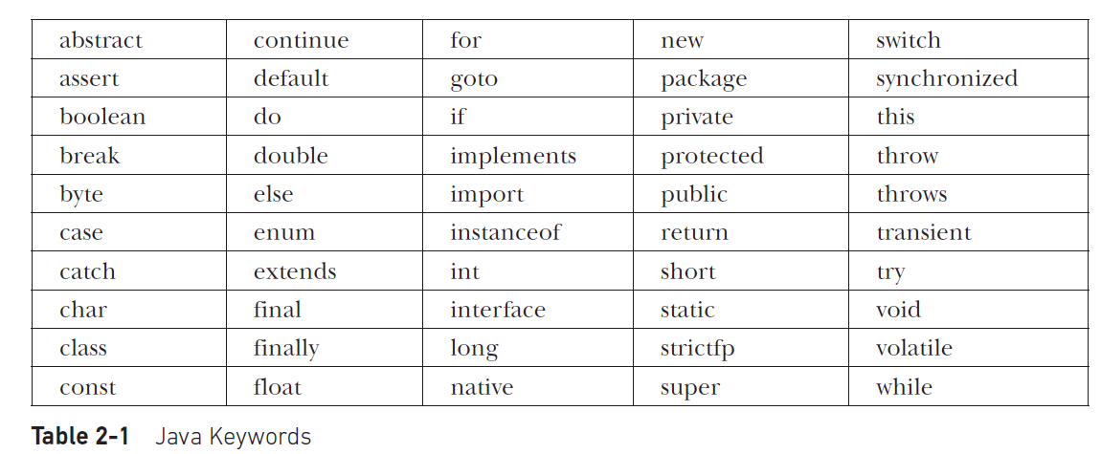
There are 50 keywords currently defined in the Java language

Slide 103
Assig 1: WAP to find the area of a circle
{
int a;
Xxxxx
{
Int y;
inner block
}
xx
}
Sop(a)

Slide 104
Scope and Lifetime of Variables
A block defines a scope. Thus, each time you start a new block, you are creating a new scope.
A scope determines what objects are visible to other parts of your program. It also determines the lifetime of those objects.
Many other computer languages define two general categories of scopes: global and local. However, these traditional scopes do not fit well with Java’s strict, object-oriented model.
In Java, the two major scopes are those defined by a class and those defined by a method.
The scope defined by a method begins with its opening curly brace. However, if that method has parameters, they too are included within the method’s scope.
As a general rule, variables declared inside a scope are not visible (that is, accessible) to code that is defined outside that scope. Thus, when you declare a variable within a scope, you are localizing that variable and protecting it from unauthorized access and/or modification.
Scopes can be nested. For example, each time you create a block of code, you are creating a new, nested scope. When this occurs, the outer scope encloses the inner scope.
Lifetime of a variable is confined to its scope.
variables are created when their scope is entered, and destroyed when their scope is left. This means that a variable will not hold its value once it has gone out of scope.

Slide 105
// Demonstrate block scope.
class Scope
{
public static void main(String args[])
{
int x; // known to all code within main
x = 10;
if(x == 10)
{ // start new scope
int y = 20; // known only to this block
// x and y both known here.
System.out.println("x and y: " + x + " " + y);
x = y * 2;
}
// y = 100; // Error! y not known here
// x is still known here.
System.out.println(“x is " +x);
}
}

Slide 106
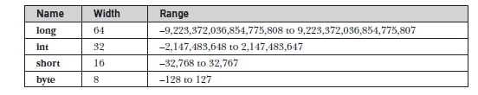

Java uses Unicode to represent characters.
Thus, in Java char is a 16-bit type. The range of a char is 0 to 65,536. There are no
negative chars.

Slide 107
Type Conversion and Casting
Java’s Automatic Conversions
When one type of data is assigned to another type of variable, an automatic type conversion
will take place if the following two conditions are met:
• The two types are compatible.
• The destination type is larger than the source type.
When these two conditions are met, a widening conversion takes place.
For example, the int type is always large enough to hold all valid byte values, so no explicit cast statement is
required.

Slide 108
Casting Incompatible Types
To create a conversion between two incompatible types, you must use a cast.
A cast is simply an explicit type conversion. It has this general form:
(target-type) value
Here, target-type specifies the desired type to convert the specified value to.
For example, the following fragment casts an int to a byte.
int a;
byte b;
// …
b = (byte) a;
This is narrowing conversion. Another one is truncation.

Slide 109
Automatic Type Promotion in Expressions
Ex 1:
byte a = 40;
byte b = 50;
byte c = 100;
int d = a * b / c;
This means that the subexpression
a*b is performed using integers—not bytes.

Slide 110
The Type Promotion Rules
Java defines several type promotion rules that apply to expressions. They are as follows:
First, all byte, short, and char values are promoted to int.
Then, if one operand is a long, the whole expression is promoted to long.
If one operand is a float, the entire expression is promoted to float. If any of the operands are double, the result is double.

Slide 111
Arrays
// Demonstrate a one-dimensional array.
class Array {
public static void main(String args[]) {
int month_days[];
month_days = new int[12];
month_days[0] = 31;
month_days[1] = 28;
month_days[2] = 31;
month_days[3] = 30;
month_days[4] = 31;
month_days[5] = 30;
month_days[6] = 31;
month_days[7] = 31;
month_days[8] = 30;
month_days[9] = 31;
month_days[10] = 30;
month_days[11] = 31;
System.out.println("April has " + month_days[3] + " days.");
}
}

Slide 112
// An improved version of the previous program.
class AutoArray {
public static void main(String args[]) {
int month_days[] = { 31, 28, 31, 30, 31, 30, 31, 31, 30, 31, 30, 31 };
System.out.println("April has " + month_days[3] + " days.");
}
}

Slide 113
// Average an array of values.
class Average {
public static void main(String args[]) {
double nums[] = {10.1, 11.2, 12.3, 13.4, 14.5};
double result = 0;
int i;
for(i=0; i<5; i++)
result = result + nums[i];
System.out.println("Average is " + result / 5);
}
}

Slide 114
// Demonstrate a two-dimensional array.
class TwoDArray {
public static void main(String args[]) {
int twoD[][]= new int[4][5];
int i, j, k = 0;
for(i=0; i<4; i++)
for(j=0; j<5; j++) {
twoD[i][j] = k;
k++;
}
for(i=0; i<4; i++) {
for(j=0; j<5; j++)
System.out.print(twoD[i][j] + " ");
System.out.println();
}
}
}
This program generates the following output:
0 1 2 3 4
5 6 7 8 9
10 11 12 13 14
15 16 17 18 19

Slide 115
Ternary operator
// Demonstrate ?.
class Ternary {
public static void main(String args[]) {
int i, k;
i = 10;
k = i < 0 ? -i : i; // get absolute value of i
System.out.print("Absolute value of ");
System.out.println(i + " is " + k);
i = -10;
k = i < 0 ? -i : i; // get absolute value of i
System.out.print("Absolute value of ");
System.out.println(i + " is " + k);
}
}
The output generated by the program is shown here:
Absolute value of 10 is 10
Absolute value of -10 is 10

Slide 116
If else
// Demonstrate if-else-if statements.
class IfElse {
public static void main(String args[]) {
int month = 4; // April
String season;
if(month == 12 || month == 1 || month == 2)
season = "Winter";
else if(month == 3 || month == 4 || month == 5)
season = "Spring";
else if(month == 6 || month == 7 || month == 8)
season = "Summer";
else if(month == 9 || month == 10 || month == 11)
season = "Autumn";
else
season = "Bogus Month";
System.out.println("April is in the " + season + ".");
}
}
Here is the output produced by the program:
April is in the Spring.

Slide 117
Switch
// A simple example of the switch.
class SampleSwitch {
public static void main(String args[]) {
for(int i=0; i<6; i++)
switch(i) {
case 0:
System.out.println("i is zero.");
break;
case 1:
System.out.println("i is one.");
break;
case 2:
System.out.println("i is two.");
break;
case 3:
System.out.println("i is three.");
break;
default:
System.out.println("i is greater than 3.");
}
}
}

Slide 118
The output produced by this program is shown here:
i is zero.
i is one.
i is two.
i is three.
i is greater than 3.
i is greater than 3.

Slide 119
// An improved version of the season program.
class Switch {
public static void main(String args[]) {
int month = 4;
String season;
switch (month) {
case 12:
case 1:
case 2:
season = "Winter";
break;
case 3:
case 4:
case 5:
season = "Spring";
break;
case 6:
case 7:
case 8:
season = "Summer";
break;
case 9:
case 10:
case 11:
season = "Autumn";
break;
default:
season = "Bogus Month";
}
System.out.println("April is in the " + season + ".");
}
}

Slide 120
While
// Demonstrate the while loop.
class While {
public static void main(String args[]) {
int n = 10;
while(n > 0) {
System.out.println("tick " + n);
n--;
}
}
}
When you run this program, it will “tick” ten times:
tick 10
tick 9
tick 8
tick 7
tick 6
tick 5
tick 4
tick 3
tick 2
tick 1

Slide 121
Write a java program to find the mid value of 100 and 200 without using division operator.

Slide 122
// The target of a loop can be empty.
class NoBody {
public static void main(String args[]) {
int i, j;
i = 100;
j = 200;
// find midpoint between i and j
while(++i < --j); // no body in this loop
System.out.println("Midpoint is " + i);
}
}
This program finds the midpoint between i and j. It generates the following output:
Midpoint is 150

Slide 123
Do-while
// Demonstrate the do-while loop.
class DoWhile {
public static void main(String args[]) {
int n = 10;
do {
System.out.println("tick " + n);
n--;
} while(n > 0);
}
}
The do-while loop is especially useful when you process a menu selection, because you will usually want the body of a menu loop to execute at least once.

Slide 124
For loop
// Declare a loop control variable inside the for.
class ForTick {
public static void main(String args[]) {
// here, n is declared inside of the for loop
for(int n=10; n>0; n--)
System.out.println(“number " + n);
}
}
When you declare a variable inside a for loop, the scope of that variable ends when the for statement does. (That is, the scope of the variable is limited to the for loop.)

Slide 125
Wap to find whether any no is prime or not

Slide 126
// Test for primes.
class FindPrime {
public static void main(String args[]) {
int num;
boolean isPrime;
num = 34;
if(num < 2) isPrime = false;
else isPrime = true;
for(int i=2; i <= num/i; i++) {
if((num % i) == 0) {
isPrime = false;
break;
}
}
if(isPrime) System.out.println("Prime");
else System.out.println("Not Prime");
}
}

Slide 127
Using comma operator
// Using the comma.
class Comma {
public static void main(String args[]) {
int a, b;
for(a=1, b=4; a<b; a++, b--) {
System.out.println("a = " + a);
System.out.println("b = " + b);
}
}
}
a = 1
b = 4
a = 2
b = 3

Slide 128
// Parts of the for loop can be empty.
class ForVar {
public static void main(String args[]) {
int i;
boolean done = false;
i = 0;
for( ; !done; ) {
System.out.println("i is " + i);
if(i == 10) done = true;
i++;
}
}
}

Slide 129
The For-Each Version of the for Loop
Beginning with JDK 5, a second form of for was defined that implements a “for-each” style loop.
A for-each style loop is designed to cycle through a collection of objects, such as an array, in strictly sequential fashion, from start to finish.
The for-each style of for is also referred to as the enhanced for loop.
The general form of the for-each version of the for is shown here:
for(type itr-var : collection) statement-block
Here, type specifies the type and itr-var specifies the name of an iteration variable that will receive the elements from a collection, one at a time, from beginning to end.
With each iteration of the loop, the next element in the collection is retrieved and stored in itr-var.
The loop repeats until all elements in the collection have been obtained.

Slide 130
// Use a for-each style for loop.
class ForEach {
public static void main(String args[]) {
int nums[] = { 21,22,23,24,25,26,27,28,29, 30 };
int sum = 0;
// use for-each style for to display and sum the values
for(int x : nums) {
System.out.println("Value is: " + x);
sum += x;
}
System.out.println("Summation: " + sum);
}
}
The output from the program is shown here:
Value is: 21
Value is: 22
Value is:2 3
Value is: 24
Value is: 25
Value is: 26
Value is: 27
Value is: 28
Value is: 29
Value is: 30
Summation:

Slide 131
Jump Statements(break,continue,return)
// Using break to exit a loop.
class BreakLoop {
public static void main(String args[]) {
for(int i=0; i<100; i++) {
if(i == 24) break; // terminate loop if i is 10
System.out.println("i: " + i);
}
System.out.println("Loop complete.");
}
}
This program generates the following output:
i: 0
i: 1
i: 2
i: 3
i: 4
i: 5
i: 6
i: 7
i: 8
i: 9
Loop complete.

Slide 132
// Demonstrate continue.
class Continue {
public static void main(String args[]) {
for(int i=0; i<10; i++) {
System.out.print(i + " ");
if (i%2 == 0) continue;
System.out.println("");
}
}
}
This code uses the % operator to check if i is even. If it is, the loop continues without
printing a newline. Here is the output from this program:
0 1
2 3
4 5
6 7
8 9

Slide 133
The General Form of a Class
A class is a template for an object, and an object is an instance of a class.
class classname {
type instance-variable1;
type instance-variable2;
// ...
type instance-variableN;
type methodname1(parameter-list) {
// body of method
}
type methodname2(parameter-list) {
// body of method
}
// ...
type methodnameN(parameter-list) {
// body of method
}
}

Slide 134
The data, or variables, defined within a class are called instance variables.
The code is contained within methods. Collectively, the methods and variables defined within a class are called members of the class.
Variables defined within a class are called instance variables because each instance of the class (that is, each object of the class) contains its own copy of these variables.
Thus, the data for one object is separate and unique from the data for another.

Slide 135
To create a class
class Box {
double width;
double height;
double depth;
}
To create an object on the class Box
Box mybox = new Box();
To access member variables:
To access these variables, dot (.) operator is used. The dot operator links the name of the object with the name of an instance variable.
Ex:
mybox.width = 100;

Slide 136
/* A program that uses the Box class.
Call this file BoxDemo.java
*/
class Box {
double width;
double height;
double depth;
}
// This class declares an object of type Box.
class BoxDemo {
public static void main(String args[]) {
Box mybox = new Box();
double vol;
// assign values to mybox's instance variables
mybox.width = 10;
mybox.height = 20;
mybox.depth = 15;
// compute volume of box
vol = mybox.width * mybox.height * mybox.depth;
System.out.println("Volume is " + vol);
}
}

Slide 137
Box mybox = new Box();
This statement combines the two steps just described. It can be rewritten like this to show each step more clearly:
Box mybox; // declare reference to object
mybox = new Box(); // allocate a Box object

Slide 138
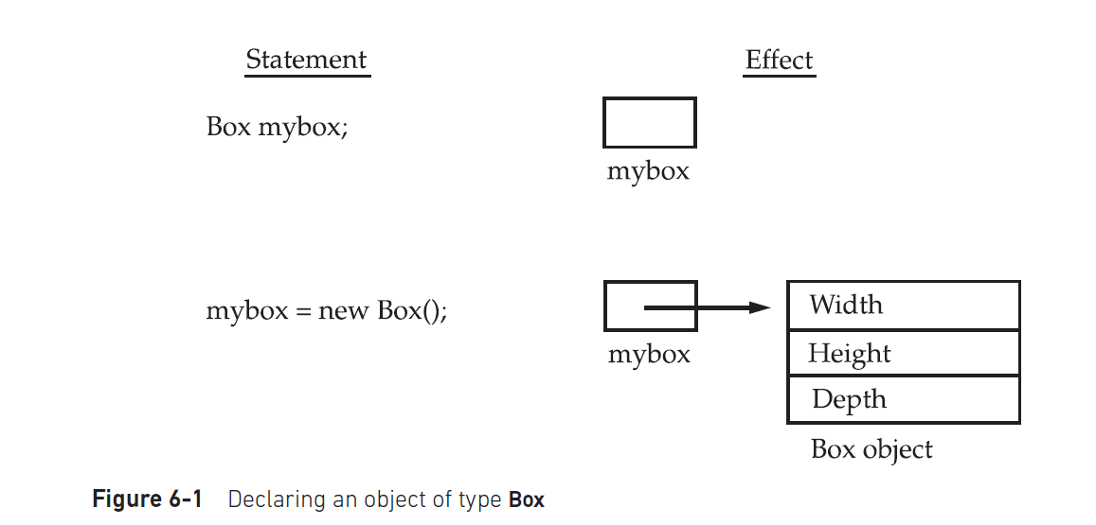

Slide 139
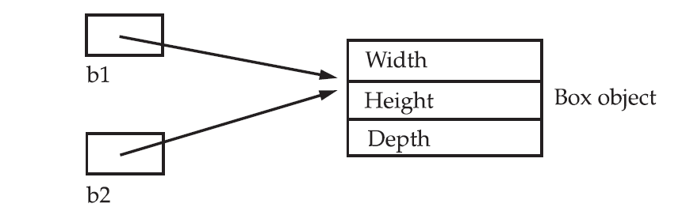
Assigning Object Reference Variables
Box b1 = new Box();
Box b2 = b1;

Slide 140
Methods
type name(parameter-list) {
// body of method
}
type specifies the type of data returned by the method. This can be any valid type, including class types that you create. If the method does not return a value, its return type must be void. The name of the method is specified by name.
The parameter-list is a sequence of type and identifier pairs separated by commas. Parameters are essentially variables that receive the value of the arguments passed to the method when it is called.
If the method has no parameters, then the parameter list will be empty.
Methods that have a return type other than void return a value to the calling routine using the following form of the return statement:
return value;

Slide 141
// This program includes a method inside the box class.
class Box {
double width;
double height;
double depth;
// display volume of a box
void volume() {
System.out.print("Volume is ");
System.out.println(width * height * depth);
}
}
class BoxDemo3 {
public static void main(String args[]) {
Box mybox1 = new Box();
Box mybox2 = new Box();
// assign values to mybox1's instance variables
mybox1.width = 10;
mybox1.height = 20;
mybox1.depth = 15;
/* assign different values to mybox2's
instance variables */
mybox2.width = 3;
mybox2.height = 6;
mybox2.depth = 9;
// display volume of first box
mybox1.volume();
// display volume of second box
mybox2.volume();
}
}

Slide 142
Volume is 3000.0(10*20*15)
Volume is 162.0(3*6*9)

Slide 143
Returning a Value
class Box {
double width;
double height;
double depth;
// compute and return volume
double volume() {
return width * height * depth;
}
}
class BoxDemo4 {
public static void main(String args[]) {
Box mybox1 = new Box();
Box mybox2 = new Box();
double vol;
// assign values to mybox1's instance variables
mybox1.width = 10;
mybox1.height = 20;
mybox1.depth = 15;
/* assign different values to mybox2's
instance variables */
mybox2.width = 3;
mybox2.height = 6;
mybox2.depth = 9;
// get volume of first box
vol = mybox1.volume();
System.out.println("Volume is " + vol);
// get volume of second box
vol = mybox2.volume();
System.out.println("Volume is " + vol);
}
}

Slide 144
public static void main(String args[]) {
Box mybox1 = new Box();
Box mybox2 = new Box();
double vol;
// initialize each box
mybox1.setDim(10, 20, 15);
mybox2.setDim(3, 6, 9);
// get volume of first box
vol = mybox1.volume();
System.out.println("Volume is " + vol);
// get volume of second box
vol = mybox2.volume();
System.out.println("Volume is " + vol);
}
}

Slide 145
Constructors
Because the requirement for initialization is so common, Java allows objects to initialize themselves when they are created.
This automatic initialization is performed through the use of a constructor.
A constructor initializes an object immediately upon creation. It has the same name as the class in which it resides and is syntactically similar to a method. Once defined, the constructor is automatically called when the object is created, before the new operator completes.
Constructors do not return any type, not even void. This is because the implicit return type of a class’ constructor is the class type itself.

Slide 146
/* Here, Box uses a constructor to initialize the
dimensions of a box.
*/
class Box {
double width;
double height;
double depth;
// This is the constructor for Box.
Box() {
System.out.println("Constructing Box");
width = w;
height = h;
depth = d;
}
// compute and return volume
double volume() {
return width * height * depth;
}
}
class BoxDemo6 {
public static void main(String args[]) {
// declare, allocate, and initialize Box objects
Box mybox1 = new Box();
Box mybox2 = new Box();
double vol;
// get volume of first box
vol = mybox1.volume();
System.out.println("Volume is " + vol);
// get volume of second box
vol = mybox2.volume();
System.out.println("Volume is " + vol);
}
}

Slide 147
constructors
class BoxDemo6 {
public static void main(String args[]) {
// declare, allocate, and initialize Box objects
Box mybox1 = new Box();
Box mybox2 = new Box();
double vol;
// get volume of first box
vol = mybox1.volume();
System.out.println("Volume is " + vol);
// get volume of second box
vol = mybox2.volume();
System.out.println("Volume is " + vol);
}
}
When this program is run, it generates the following results:
Constructing Box
Constructing Box
Volume is 1000.0
Volume is 1000.0

Slide 148
Parameterized Constructors
/* Here, Box uses a parameterized constructor to
initialize the dimensions of a box.
*/
class Box {
double width;
double height;
double depth;
// This is the constructor for Box.
Box(double w, double h, double d) {
width = w;
height = h;
depth = d;
}
// compute and return volume
double volume() {
return width * height * depth;
}
}
class BoxDemo7 {
public static void main(String args[]) {
// declare, allocate, and initialize Box objects
Box mybox1 = new Box(10, 20, 15);
Box mybox2 = new Box(3, 6, 9);
double vol;
// get volume of first box
vol = mybox1.volume();
System.out.println("Volume is " + vol);
// get volume of second box
vol = mybox2.volume();
System.out.println("Volume is " + vol);
}
}
The output from this program is shown here:
Volume is 3000.0
Volume is 162.0

Slide 149
Overloading Methods
Two or more methods within the same class that share the same name, but their parameter declarations are different.
Method overloading is one of the ways that Java supports polymorphism.

Slide 150
// Demonstrate method overloading.
class OverloadDemo {
void test() {
System.out.println("No parameters");
}
// Overload test for one integer parameter.
void test(int a) {
System.out.println("a: " + a);
}
// Overload test for two integer parameters.
void test(int a, int b) {
System.out.println("a and b: " + a + " " + b);
}
// Overload test for a double parameter
double test(double a) {
System.out.println("double a: " + a);
return a*a;
}
}
class Overload {
public static void main(String args[]) {
OverloadDemo ob = new OverloadDemo();
double result;

Slide 151
// call all versions of test()
ob.test();
ob.test(10);
ob.test(10, 20);
result = ob.test(123.25);
System.out.println("Result of ob.test(123.25): " + result);
}
}
This program generates the following output:
No parameters
a: 10
a and b: 10 20
double a: 123.25
Result of ob.test(123.25): 15190.5625
Note:In some cases, Java’s automatic type conversions can play a role in overload resolution.

Slide 152
Overloading Constructors
/* Here, Box defines three constructors to initialize
the dimensions of a box various ways.
*/
class Box {
double width;
double height;
double depth;
// constructor used when all dimensions specified
Box(double w, double h, double d) {
width = w;
height = h;
depth = d;
}
// constructor used when no dimensions specified
Box() {
width = 10 // use -1 to indicate
height = 20; // an uninitialized
depth = 30; // box
}
// constructor used when cube is created
Box(double len) {
width = height = depth = len;
}
// compute and return volume
double volume() {
return width * height * depth;
}
}

Slide 153
// This program uses a parameterized method.
class Box {
double width;
double height;
double depth;
// compute and return volume
double volume() {
return width * height * depth;
}
// sets dimensions of box
void setDim(double w, double h, double d) {
width = w;
height = h;
depth = d;
}
}
Class BoxDemo5 {

Slide 154
// get volume of cube
vol = mycube.volume();
System.out.println("Volume of mycube is " + vol);
}
}
The output produced by this program is shown here:
Volume of mybox1 is 3000.0
Volume of mybox2 is -1.0
Volume of mycube is 343.0

Slide 155
class OverloadCons {
public static void main(String args[]) {
// create boxes using the various constructors
Box mybox1 = new Box(10, 20, 15);
Box mybox2 = new Box();
Box mycube = new Box(7);
double vol;
// get volume of first box
vol = mybox1.volume();
System.out.println("Volume of mybox1 is " + vol);
// get volume of second box
vol = mybox2.volume();
System.out.println("Volume of mybox2 is " + vol);

Slide 156
Using Objects as Parameters
// Objects may be passed to methods.
class Test {
int a, b;
Test(int i, int j) {
a = i;
b = j;
}
// return true if o is equal to the invoking object
boolean equalTo(Test o) {
int x,y;
if(o.a == x&& o.b == y) return true;
else return false;
}
}

Slide 157
class PassOb {
public static void main(String args[]) {
Test ob1 = new Test(100, 22);
Test ob2 = new Test(100, 22);
Test ob3 = new Test(-1, -1);
System.out.println("ob1 == ob2: " + ob1.equalTo(ob2));
System.out.println("ob1 == ob3: " + ob1.equalTo(ob3));
}
}
This program generates the following output:
ob1 == ob2: true
ob1 == ob3: false

Slide 158
Inheritance
The process by which one class acquires the properties and functionalities of another class
provides the idea of reusability of code
class which inherits the properties of other is known as child class/derived class/sub class
the class whose properties are inherited is known as parent class/base class /super class

Slide 159
Inheritance
it allows the creation of hierarchical classifications.
Using inheritance, you can create a general class that defines traits common to a set of related items. This class can then be inherited by other, more specific classes, each adding those things that are unique to it.
In the terminology of Java, a class that is inherited is called a superclass.
The class that does the inheriting is called a subclass. Therefore, a subclass is a specialized version of a superclass. It inherits all of the members defined by the superclass and adds its own, unique elements.

Slide 160
To inherit a class extends keyword is used. class subclass-name extends superclass-name { // body of class }
// A simple example of inheritance.
// Create a superclass.
class A {
int i, j;
void showij() {
System.out.println("i and j: " + i + " " + j);//i and j: 5 2
}
}
// Create a subclass by extending class A.
class B extends A {
int k;
void showk() {
System.out.println("k: " + k);
}
void sum() {
System.out.println("i+j+k: " + (i+j+k));
}
}

Slide 161
class SimpleInheritance {
public static void main(String args []) {
A superOb = new A();
B subOb = new B();
// The superclass may be used by itself.
superOb.i = 10;
superOb.j = 20;
System.out.println("Contents of superOb: ");
superOb.showij();
System.out.println();
/* The subclass has access to all public members of
its superclass. */
subOb.i = 7;
subOb.j = 8;
subOb.k = 9;
System.out.println("Contents of subOb: ");
subOb.showij();
subOb.showk();
System.out.println();
System.out.println("Sum of i, j and k in subOb:");
subOb.sum();
}
}

Slide 162
The output from this program is shown here:
Contents of superOb:
i and j: 10 20
Contents of subOb:
i and j: 7 8
k: 9
Sum of i, j and k in subOb:
i+j+k: 24

Slide 163
Member Access and Inheritance:
Although a subclass includes all of the members of its superclass, it cannot access those members of the superclass that have been declared as private.

Slide 164
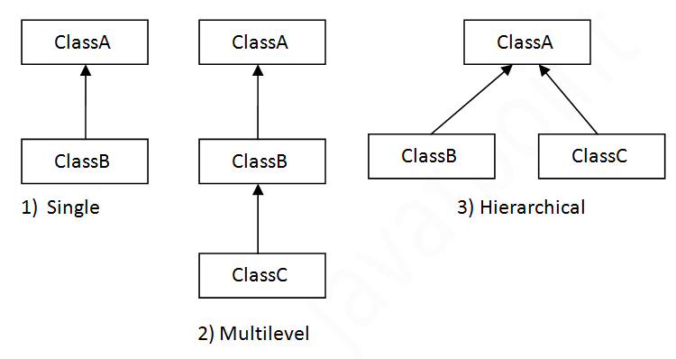
Types of inheritance

Slide 165
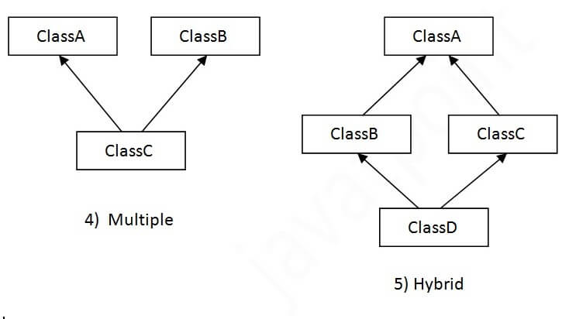
Types of inheritance

Slide 166
On the basis of class, there can be three types of inheritance in java: single, multilevel and hierarchical.
In java programming, multiple and hybrid inheritance is supported through interface only

Slide 167
SUPER KEYWORD
super keyword is used for
To call parent class constructor
To refer parent class data members
To refer parent class methods
Note:The super keyword is used inside the child class only

Slide 168
Using super to Call Superclass Constructors
A subclass can call a constructor defined by its superclass by use of the following form of super:
super(arg-list);
super( ) must always be the first statement executed inside a subclass’ constructor.
class Box {
double width;
double height;
double depth;
// construct clone of an object
Box( double wi, double hi, double de)
{
width = wi;
height = hi;
depth = de;
}
}
class BoxWeight extends Box {
double weight; // weight of box
// initialize width, height, and depth using super()
BoxWeight(double w, double h, double d, double m)
{
super(w, h, d); // call superclass constructor
weight = m;
}
}

Slide 169
To refer parent class data members
This usage has the following general form super.member
Here, member can be either a method or an instance variable.
// Using super to overcome name hiding.
class A {
int i;
}
// Create a subclass by extending class A.
class B extends A {
int i; // this i hides the i in A
B(int a, int b) {
super.i = a; // i in A
i = b; // i in B
}
void show() {
System.out.println("i in superclass: " + super.i);
System.out.println("i in subclass: " + i);
}
}

Slide 170
class UseSuper {
public static void main(String args[]) {
B subOb = new B(1, 2);
subOb.show();
}
}
This program displays the following:
i in superclass: 1
i in subclass: 2
Although the instance variable i in B hides the i in A, super allows access to the I defined in the superclass. As you will see, super can also be used to call methods that are
hidden by a subclass.

Slide 171
// Demonstrate when constructors are executed. // Create a super class. class A { A() { System.out.println("Inside A's constructor."); } } // Create a subclass by extending class A. class B extends A { B() { System.out.println("Inside B's constructor."); } } | // Create another subclass by extending B. class C extends B { C() { System.out.println("Inside C's constructor."); } } class CallingCons { public static void main(String args[]) { C c = new C(); } } The output from this program is shown here: Inside A's constructor Inside B's constructor Inside C's constructor

Slide 172
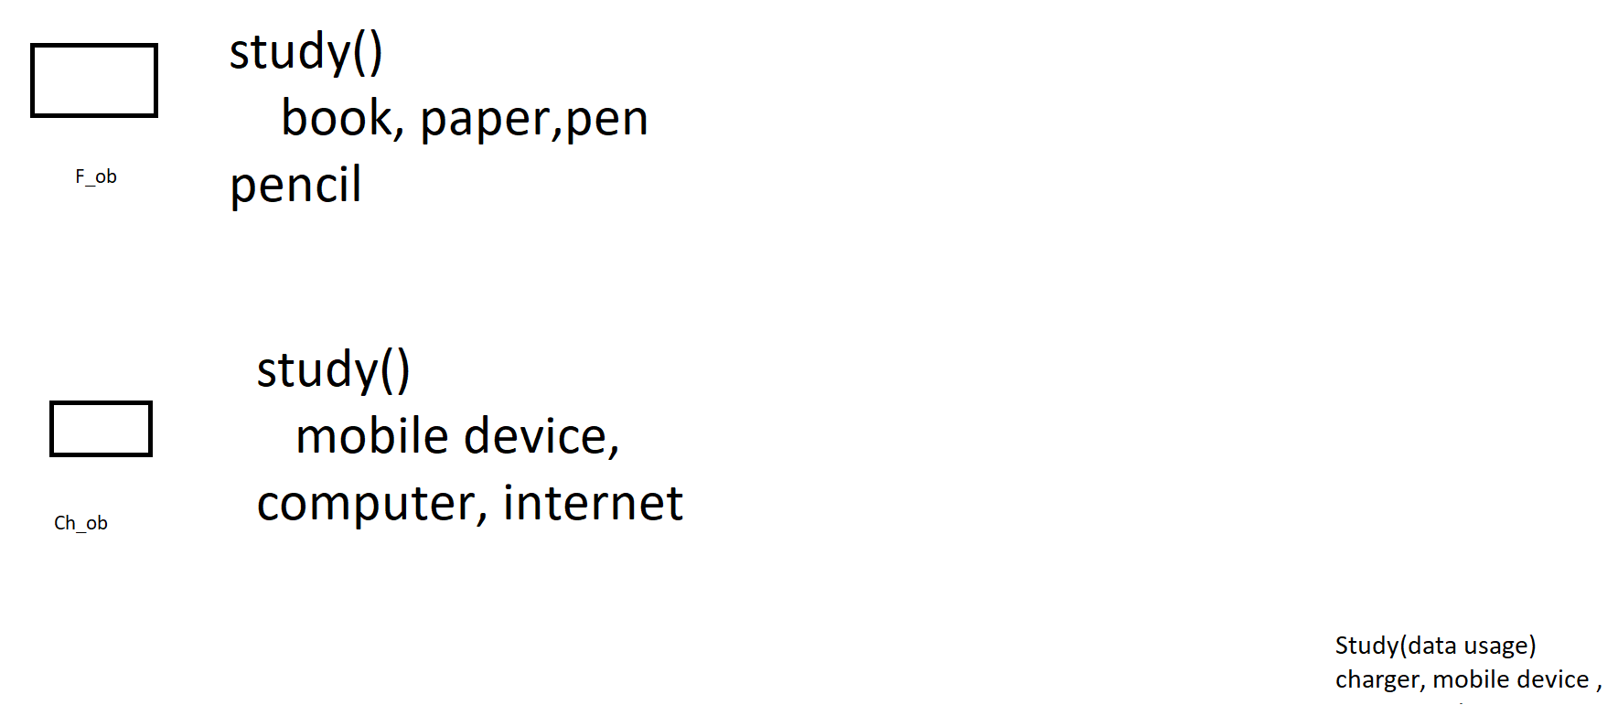
Method Overriding
In a class hierarchy, when a method in a subclass has the same name and type signature as a method in its superclass, then the method in the subclass is said to override the method in the superclass.
When an overridden method is called from within its subclass, it will always refer to the version of that method defined by the subclass.

Slide 173
// Method overriding. class A { int i, j; A(int a, int b) { i = a; j = b; } // display i and j void show() { System.out.println("i and j: " + i + " " + j); } } class B extends A { int k; B(int a, int b, int c) { super(a, b); k = c; } | // display k – this overrides show() in A void show() { System.out.println("k: " + k); } } class Override { public static void main(String args[]) { B subOb = new B(1, 2, 3); subOb.show(); // this calls show() in B } } The output produced by this program is shown here: k: 3

Slide 174
class B extends A {
int k;
B(int a, int b, int c) {
super(a, b);
k = c;
}
void show() {
super.show(); // this calls A's show()
System.out.println("k: " + k);
}
}
If you substitute this version of A into the previous program, you will see the following
output:
i and j: 1 2
k: 3
Here, super.show( ) calls the superclass version of show( ).

Slide 175
Method overriding occurs only when the names and the type signatures of the two methods are identical. If they are not, then the two methods are simply overloaded.
i.e, Methods with differing type signatures are overloaded – not overridden.

Slide 176
class A { int i, j; A(int a, int b) { i = a; j = b; } // display i and j void show() { System.out.println("i and j: " + i + " " + j); } } // Create a subclass by extending class A. class B extends A { int k; B(int a, int b, int c) { super(a, b); k = c; } | // overload show() void show(String msg) { System.out.println(msg + k); } } class Override { public static void main(String args[]) { B subOb = new B(1, 2, 3); subOb.show("This is k: "); // this calls show() in B subOb.show(); // this calls show() in A } } The output produced by this program is shown here: This is k: 3 i and j: 1 2

Slide 177
Dynamic Method Dispatch
Method overriding forms the basis for one of Java’s most powerful concepts: dynamic method dispatch.
Dynamic method dispatch is the mechanism by which a call to an overridden method is resolved at run time, rather than compile time.
Dynamic method dispatch is important because this is how Java implements run-time polymorphism.

Slide 178
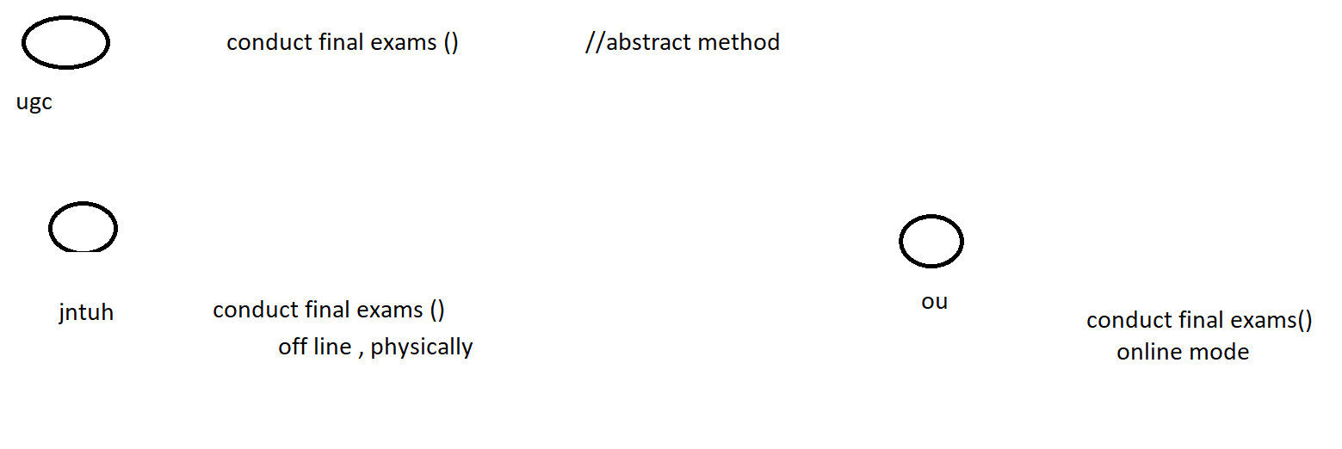
Abstract Classes

Slide 179
Abstract Classes
There are situations in which you will want to define a superclass that declares the structure of a given abstraction without providing a complete implementation of every method.
That is, sometimes you will want to create a superclass that only defines a generalized form that will be shared by all of its subclasses, leaving it to each subclass to fill in the details.
Such a class determines the nature of the methods that the subclasses must implement.
One way this situation can occur is when a superclass is unable to create a meaningful implementation for a method.

Slide 180
To declare an abstract method, use this general form:
abstract type name(parameter-list);
As you can see, no method body is present.
Any class that contains one or more abstract methods must also be declared abstract.
To declare a class abstract, you simply use the abstract keyword in front of the class keyword at
the beginning of the class declaration.
There can be no objects of an abstract class. Because it is not fully defined.
That is, an abstract class cannot be directly instantiated with the new operator.

Slide 181
// A Simple demonstration of abstract.
abstract class A {
abstract void callme();
// concrete methods are still allowed in abstract classes
void callmetoo() {
System.out.println("This is a concrete method.");
}
}
class B extends A {
void callme() {
System.out.println("B's implementation of callme.");
}
}
class AbstractDemo {
public static void main(String args[]) {
B b = new B();
b.callme();
b.callmetoo();
}
}

Slide 182
Although abstract classes cannot be used to instantiate objects, they can be used to create object references, because Java’s approach to run-time polymorphism is implemented through the use of superclass references.

Slide 183
Final keyword
The final keyword in java is used to restrict the user.
It is used at variable level, method level and class level.
It is used to make a variable as a constant, to restrict method overriding and to restrict inheritance.

Slide 184
Output: Compile Time Error
Final keyword at variable level class Entry { final int temperature=98.3; void test() { temperature=tmeperature+20; } psv main(String args[]) { Entry obj=new Entry(); obj.test(); } }//end of class | Final Keyword at method level class Entry { final void into() { Sopln(“allowed"); } } class college extends Entry { void into() { Sopln(“can not be allowed"); } psvmain(String args[]) { Entry obj=new Entry(); obj.into(); } } | Final Keyword at Class Level final class Entry { } class state extends Entry { void run() { Sopln("running safely with 100kmph"); } psvm(String args[]) { Honda1 h= new Honda1(); h.run(); } }

Slide 185
Polymorphism
Is the process of defining same method with different implementation.
That means creating multiple methods with different behaviors.
In java, polymorphism implemented using method overloading and method overriding.
1. Ad hoc polymorphism
2. Pure polymorphism

Slide 186
Ad hoc polymorphism
ad hoc polymorphism is a technique used to define the same method with different implementations and different arguments. In java programming language, ad hoc polymorphism carried out with a method overloading concept. | Class Abc { void add(int a, int b) { sop(a+b); } void add(int a, int b, int c) { sop(a+b+c); } } Class xyz { psvm(String[] args) { abc ob=new abc(); ob.add(10,20); ob.add(10,20.30); } }

Slide 187
Pure polymorphism
The pure polymorphism is a technique used to define the same method with the same arguments but different implementations. In a java programming language, pure polymorphism carried out with a method overriding concept. Method Overriding The method must have the same name as in the parent class The method must have the same parameter as in the parent class | class Bike { void run() { Sopln("running");} } class Splendor extends Bike { void run() { Sopln("running safely with 60km"); } psvm(String args[]) { Bike b = new Splendor(); b.run(); } }

Slide 188
Forms of Inheritance

Slide 189
Forms of Inheritance
Inheritance is used in a variety of way and for a variety of different purposes .
Inheritance for Specialization
Inheritance for Specification
Inheritance for Construction
Inheritance for Extension
Inheritance for Limitation
Inheritance for Combination

Slide 190
Specialization
Most commonly used inheritance and sub classification is for specialization.
Always creates a subtype, and the principles of substitutability is explicitly upheld.
It is the most ideal form of inheritance.
An example of subclassification for specialization is;
public class cse extends Engineering{
// body of class
}

Slide 191
Specialization
By far the most common form of inheritance is for specialization.
Child class is a specialized form of parent class
Principle of substitutability holds
A good example is the Java hierarchy of Graphical components in the AWT:
Component
Label
Button
TextComponent
TextArea
TextField
CheckBox
ScrollBar
Figure:
rectangle, triangle,square,circle

Slide 192
Specification
The parent class defines behavior that is implemented in the child class but not in the parent class.
If the parent class is abstract, we often say that it is providing a specification for the child class, and therefore it is specification inheritance (a variety of specialization inheritance).
Example: Java Event Listeners
ActionListener, MouseListener, and so on specify behavior, but must be subclassed.

Slide 193
Construction
The child class makes use of the behavior provided by the parent class, but is not a subtype of the parent class.
If the parent class is used as a source for behavior, but the child class has no is-a relationship to the parent, then we say the child class is using inheritance for construction.
An example might be subclassing the idea of a Set from an existing List class.

Slide 194
Extension
The child class adds new functionality to the parent class, but does not change any inherited behavior.
If a child class generalizes or extends the parent class by providing more functionality, but does not override any method, we call it inheritance for generalization. The child class doesn't change anything inherited from the parent, it simply adds new features.
An example is Java Properties inheriting from Hashtable.

Slide 195
Limitation
The child class restricts the use of some of the behavior inherited from the parent class.
If a child class overrides a method inherited from the parent in a way that makes it unusable (for example, issues an error message), then we call it inheritance for limitation.
For example, you have an existing List data type that allows items to be inserted at either end, and you override methods allowing insertion at one end in order to create a Stack.

Slide 196
Combination
The child class inherits features from more than one parent class.
This is multiple inheritance.
Java does not support multiple inheritance type.

Slide 197
Benefits of Inheritance
Inheritance helps in code reuse. The child class may use the code defined in the parent class without re-writing it.
Inheritance can save time and effort as the main code need not be written again.
Inheritance provides a clear model structure which is easy to understand.
An inheritance leads to less development and maintenance costs.
With inheritance, we will be able to override the methods of the base class so that the meaningful implementation of the base class method can be designed in the derived class.
In inheritance base class can decide to keep some data private so that it cannot be altered by the derived class.

Slide 198
Costs of Inheritance
Inheritance decreases the execution speed due to the increased time and effort it takes, the program to jump through all the levels of overloaded classes.
Inheritance makes the two classes (base and inherited class) get tightly coupled. This means one cannot be used independently of each other.
The changes made in the parent class will affect the behavior of child class too.
The overuse of inheritance makes the program more complex.

